Slide 1

Wind Gust Climatology
Brennan Dettmann
Valparaiso University
Meteorology Major
Weather Ready Nation
Juneau Weather Forecast Office
Mentor: Bryan Caffrey
29 July 2020

Slide 2
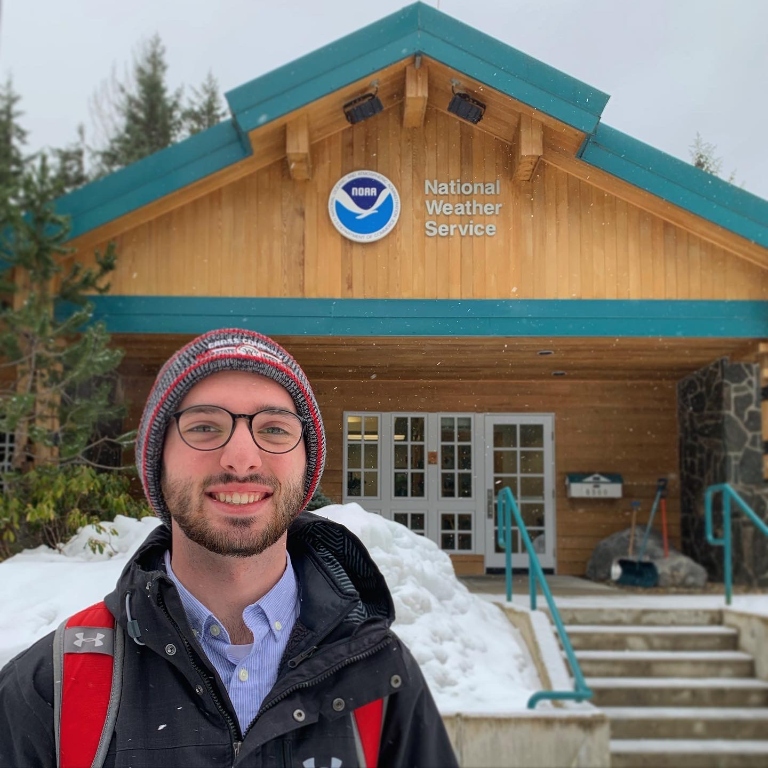
Outline
Background
Objectives
Methodology
Results
Summary
Future Work
Acknowledgements
Taken during my site visit to the NWS Juneau Office in March.
2

Slide 3
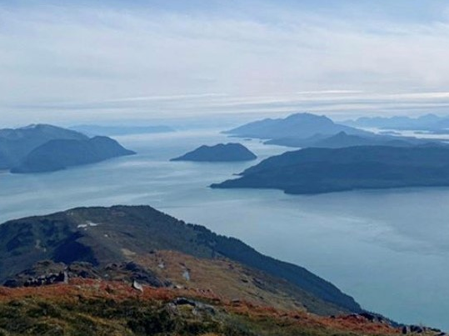
Background
Facts about Southeast Alaska (SEAK):
Very complex terrain
Harder to forecast wind
Covers roughly 35,138 square miles of land
Population of ~ 72,373 people
West Peak Mountain facing south towards the Gastineau Channel and Admiralty Island. Photo courtesy of Cody Moore.
3

Slide 4
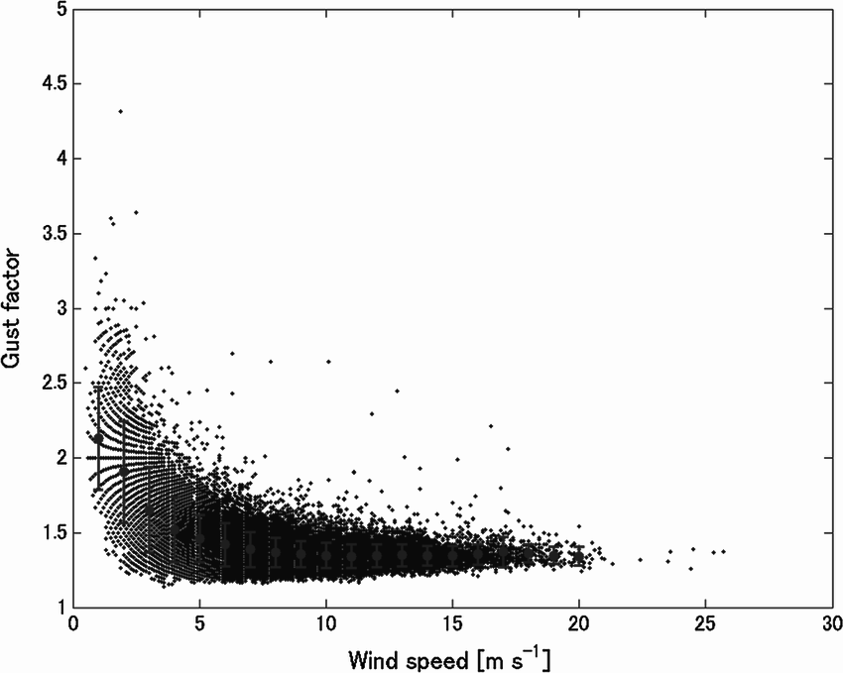
Background Cont.
Arbitrary Gust Factor vs. Sustained Wind Speed Plot
Gust Forecast History:
Old Model:
Flat 1.2 gust factor
Gust Forecast = (1.2) * (Sustained Wind Speed)
Typically underestimates for lower wind speeds
Current Model:
Region-specific power model
y = ax^{b}
Better predicting power than flat 1.2 gust factor¹
Flat Multiplier
Nishida, Tomoya & Waseda, Takuji. (2015). The Impact of the Winter Monsoon on Marine Surface-Layer Turbulence. Boundary-Layer Meteorology. 157. 10.1007/s10546-015-0053-5.
4
Clinch, K., and Caffrey, B.. Improving Wind Gust Forecasts in Southeast Alaska. 2016.

Slide 5
Objectives
Goal: With over 4 years of new data and a wider network of stations, the office aims to improve wind gust forecasts through a research experiment.
Question: Will statistical analysis and an increased observation density improve wind gust forecasts across the complex terrain of Southeast Alaska?
Hypothesis: After witnessing the predicting power of a power model, it is evident that a higher gust factor is more effective for lower wind speeds. Following the success of Kimberly’s findings, it is expected that a higher observation density will lead to more refined equations and ultimately more accurate forecasts.
5

Slide 6
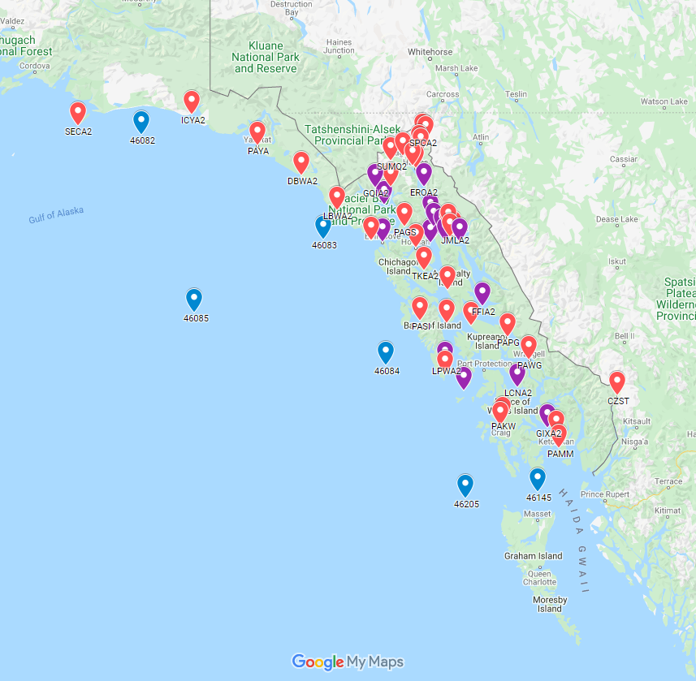
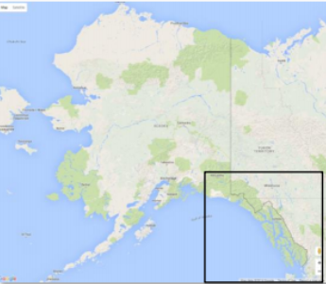
Methodology
Data:
Pulled from 97 unique observation sites
Three primary databases
Alaska Ocean Observing System (AOOS)
Synoptic Data - MesoWest
National Data Buoy Center (NDBC)
Created Python scripts to “clean” files
Separated into 27 zones based on location
24 additional smaller groups
Figure illustrates 57 of the observations sites in SE AK. Red indicates land-based sites, purple indicates channel-based, and blue indicates gulf-based.
6

Slide 7
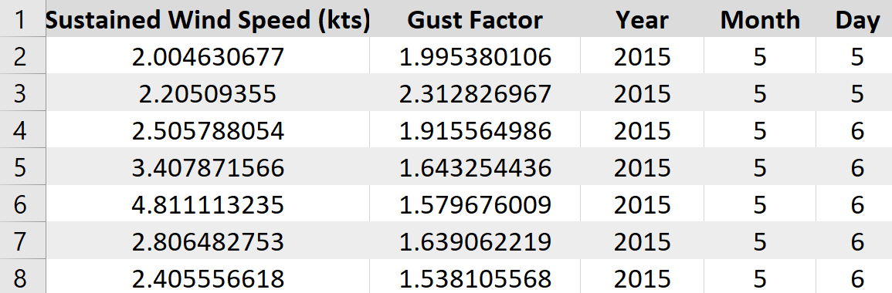
Methodology Cont.
For each observation site:
Calculate gust factor
Gust Factor = Gust Wind Speed / Sustained Wind Speed
Sort data by wind direction into 9 separate files
Each cardinal direction (ex. east, north, southwest, etc.)
One file containing all data points
MVXA2 (Mendenhall Valley) NW file:
For each zone:
Concatenate files together
End with 9 separate files for each zone
7

Slide 8
Methodology Cont.
Create Power Models:
Analyzing relationship between gust factor and sustained wind speed values
Find a and b such that y = ax^{b}
Transformed power function by taking natural logarithm of each side
Used linear regression to find appropriate coefficients
Assessed goodness of fit with R-squared values
Portion of Code Used in R:
model = lm(log(data$GustMult)~log(data$SusWindSpeed))
coefs = unname(coef(model))
coefa = exp(coefs[1])
coefb = coefs[2]
rsquared = summary(model)$r.squared
8

Slide 9
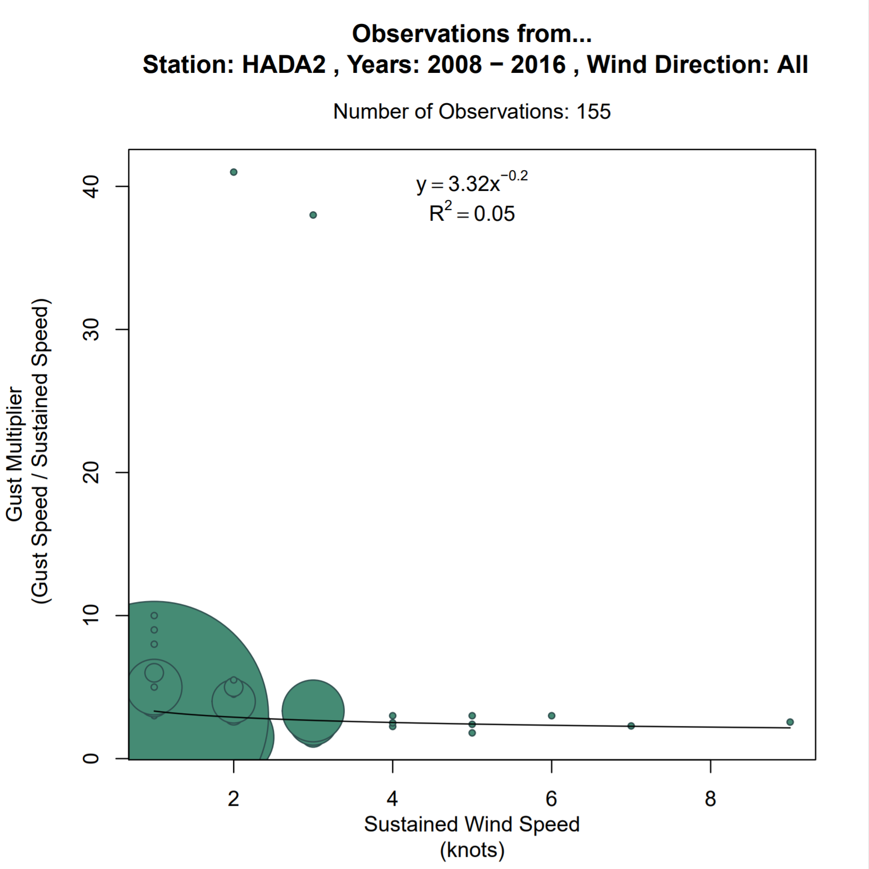
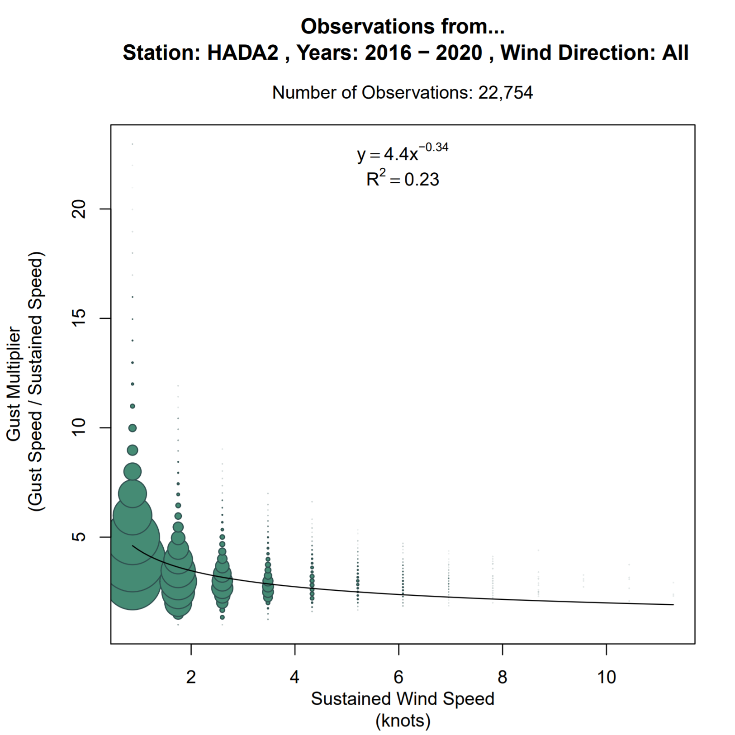
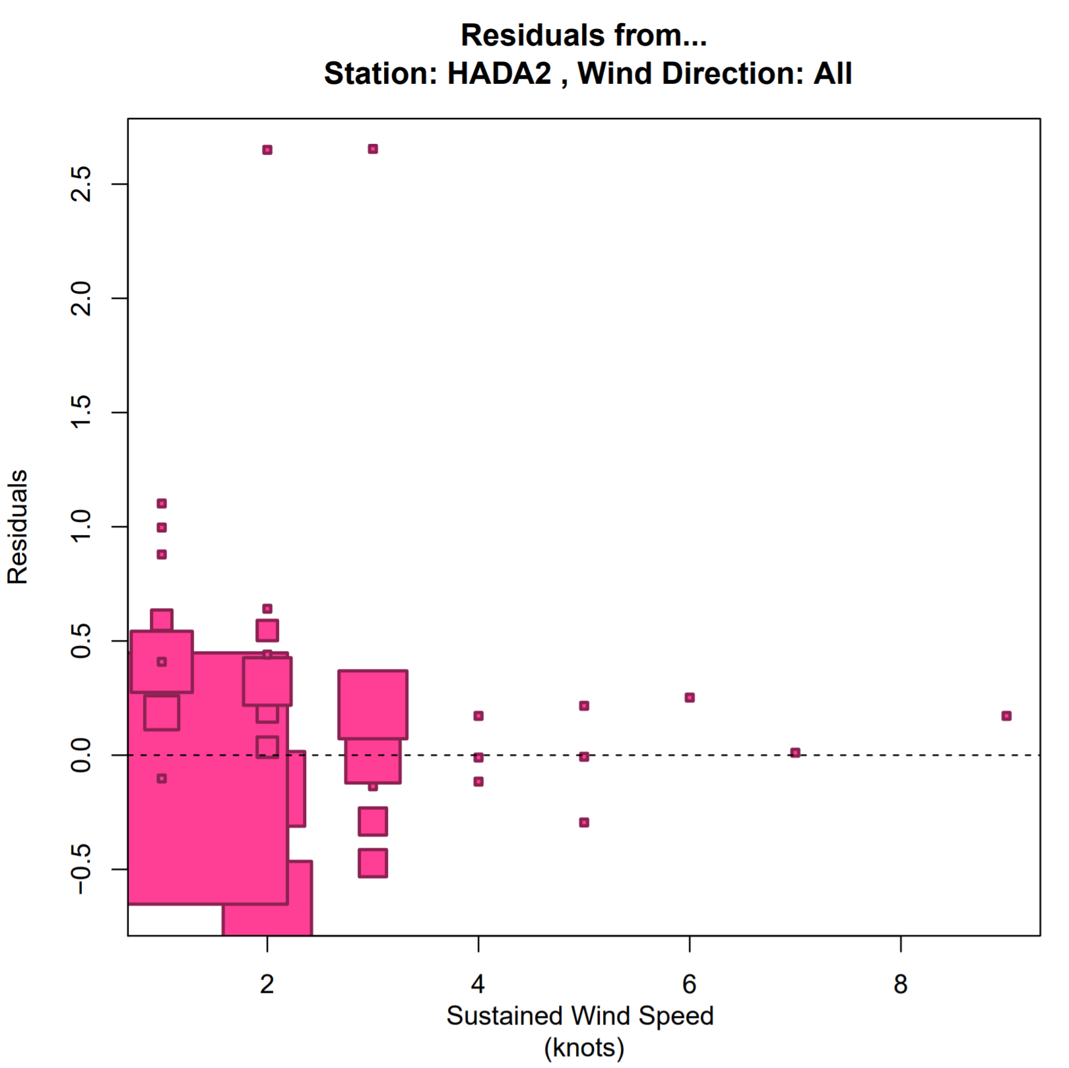
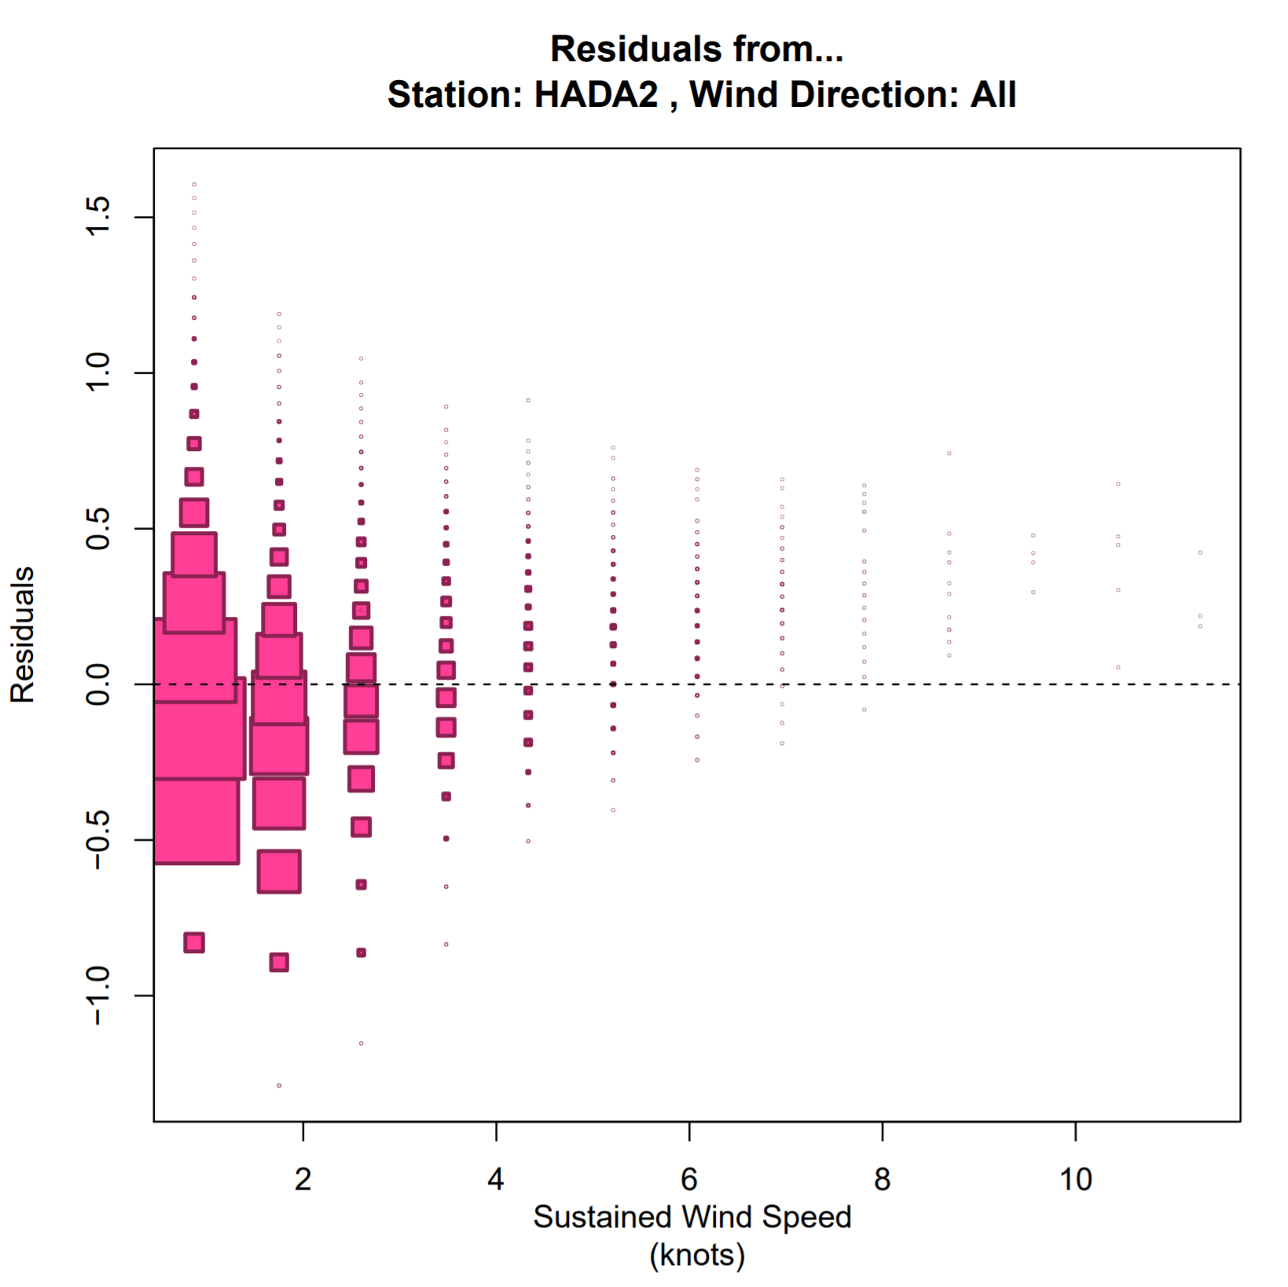
Results: Comparing 2016 & 2020 Studies (HADA2 - Hydaburg, AK)
2016: Initial Power Model
2020: Refined Power Model
Total Observations:
155 --> 22,764
R-Squared values:
0.05 --> 0.23
9

Slide 10
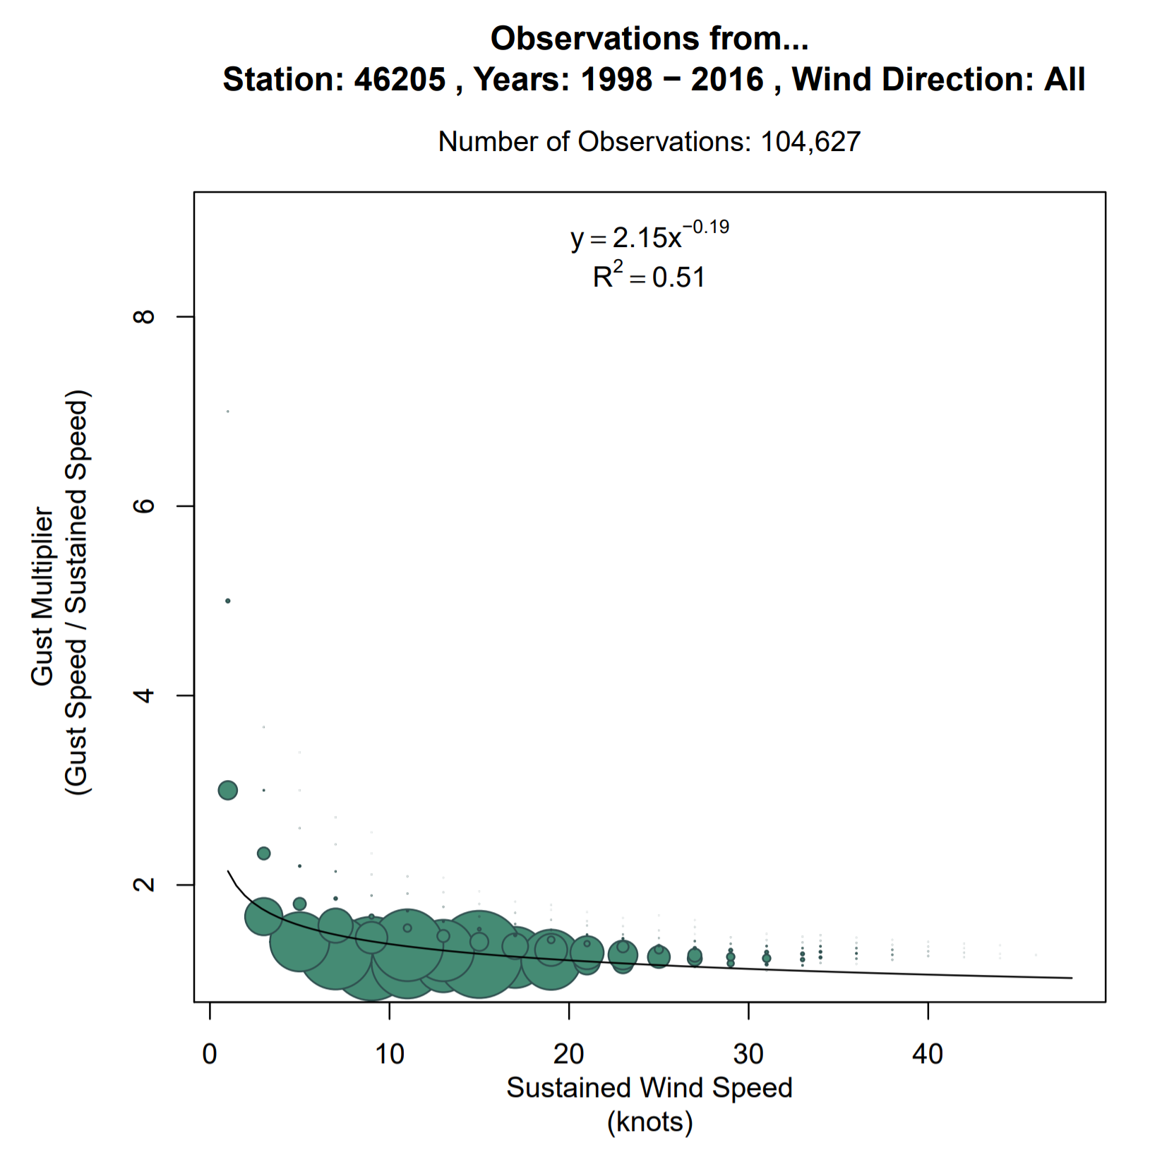
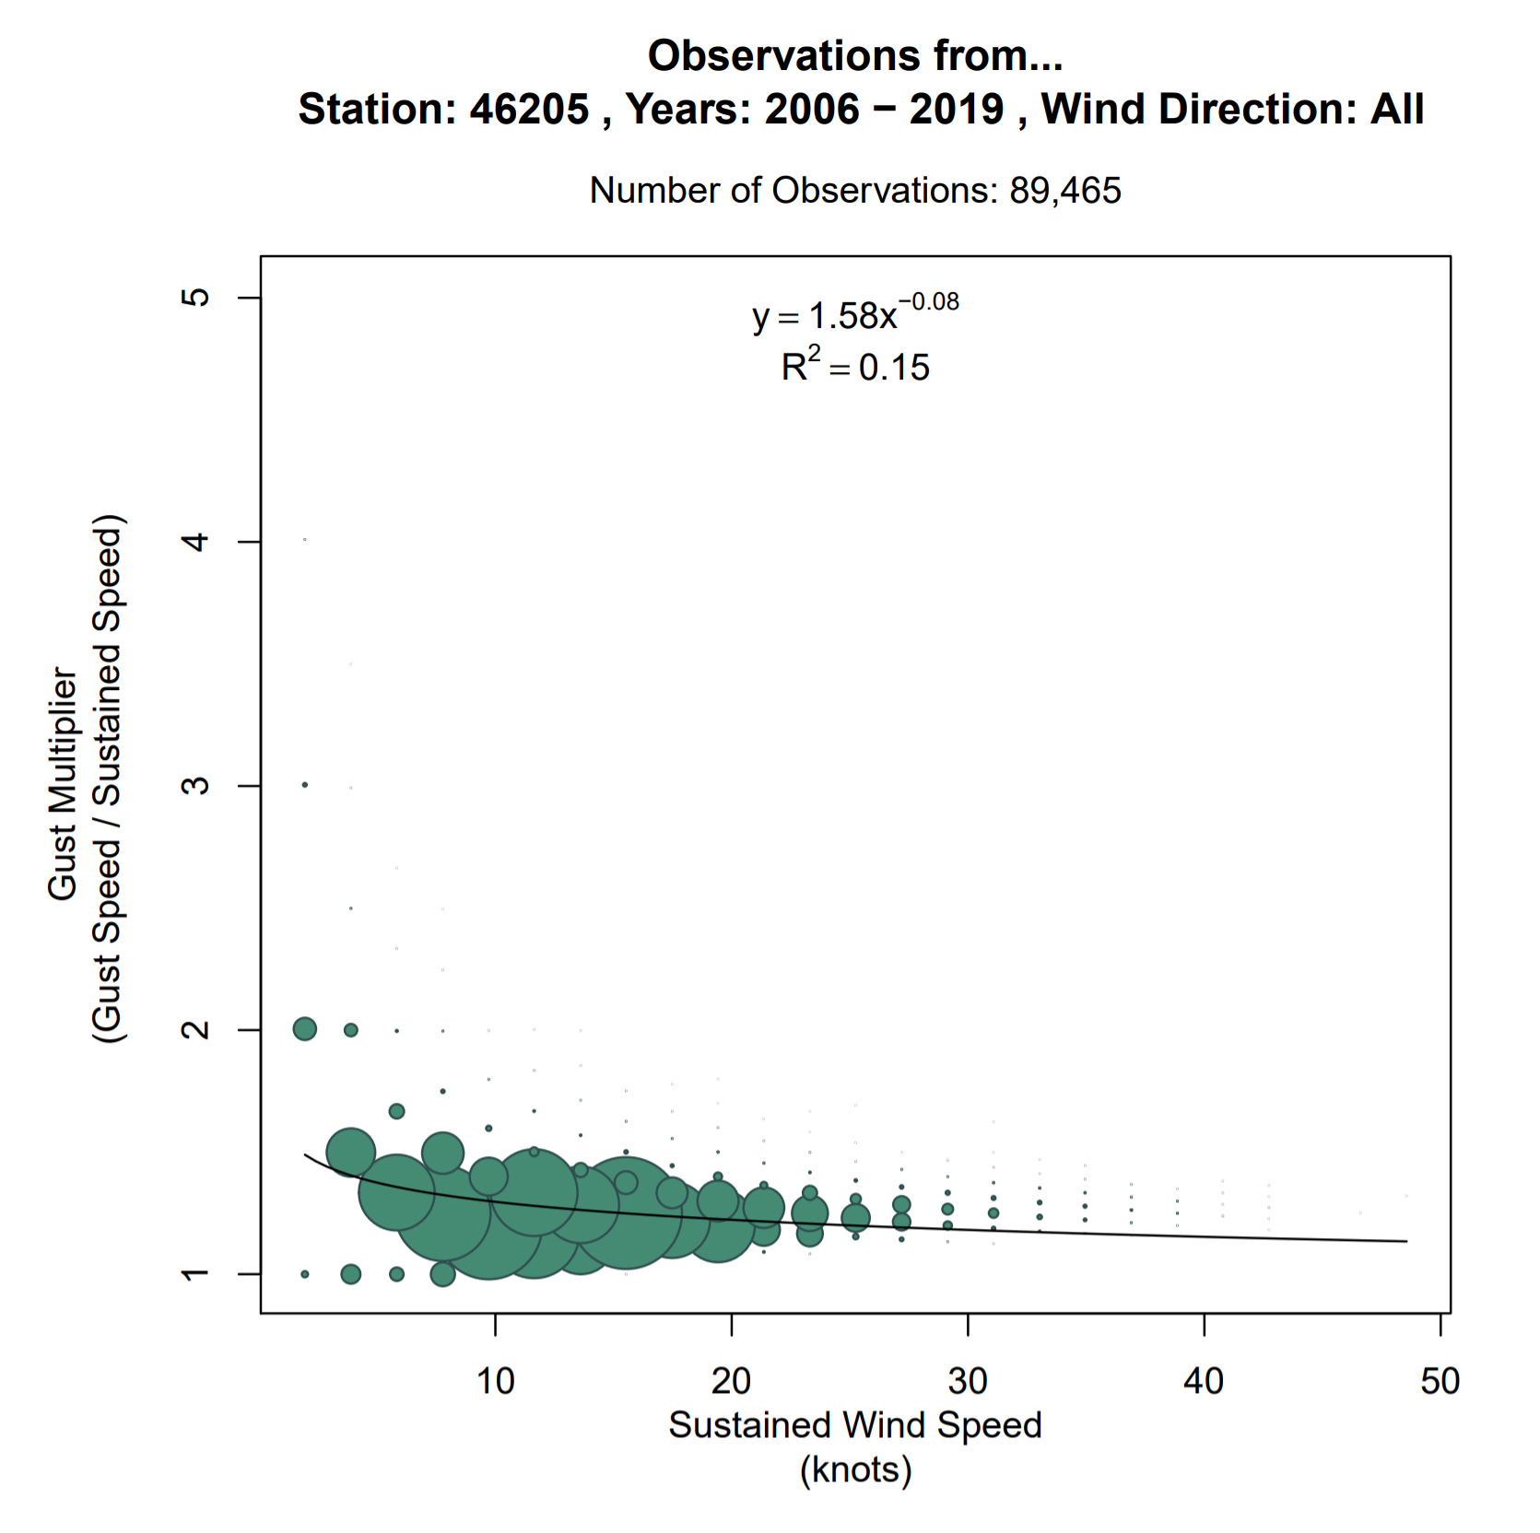
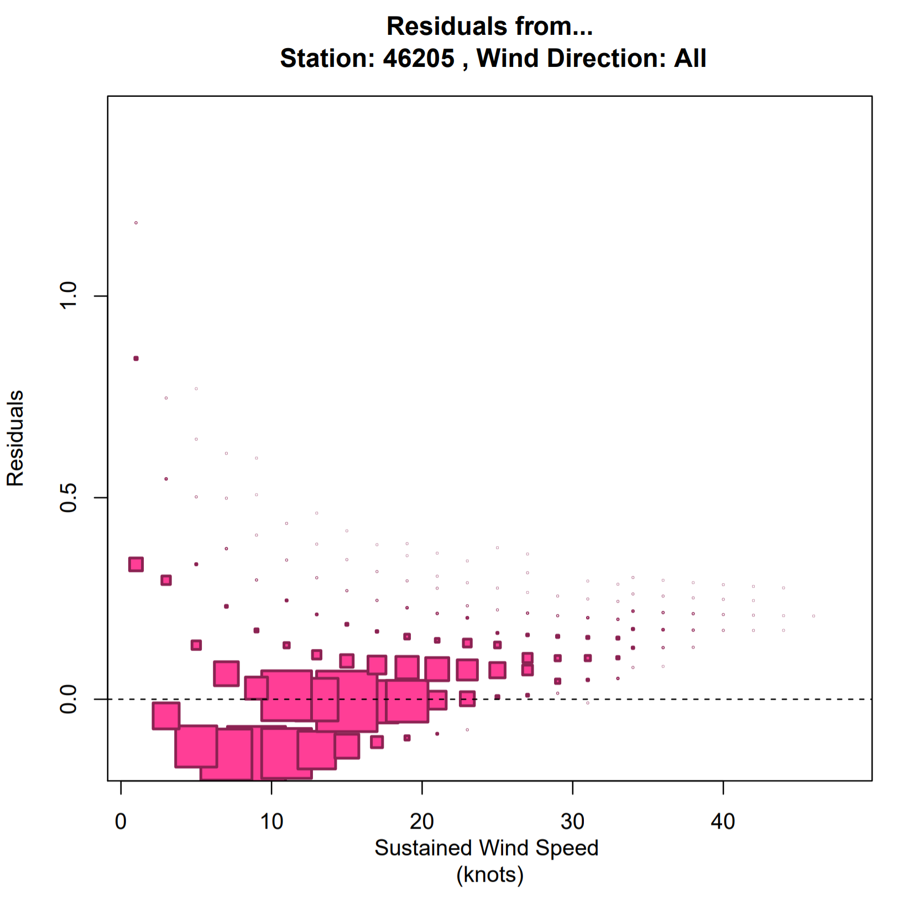
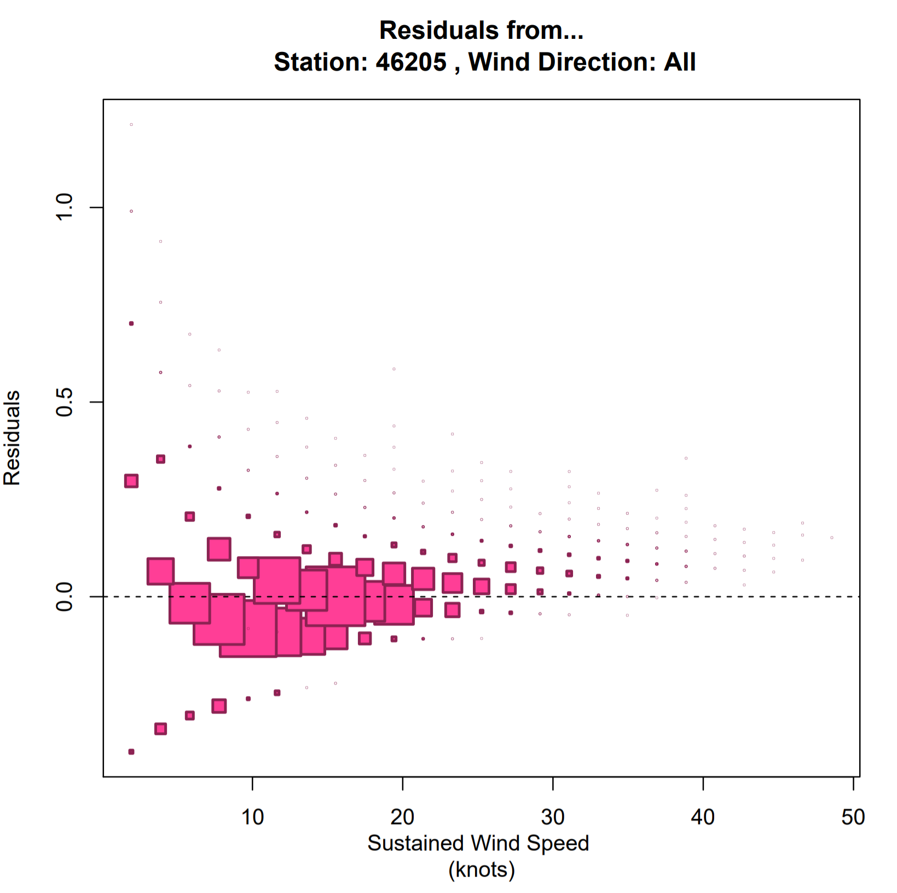
Results: Comparing 2016 & 2020 Studies (46205 - Buoy SE Gulf of AK)
2016: Initial Power Model
2020: Refined Power Model
Total Observations:
104,627 -> 89,465
R-Squared values:
0.51 -> 0.15
10

Slide 11
Results: Comparing 2016 & 2020 Studies (R-Squared Values)
Land Observation Sites (28):
Total Change: | 7.497759205 | 749.78%
Average Change: | 0.03023290002 | 3.02%
Land & Inner Channel (28 + 5 = 33):
Total Change (Land & Inner Channels): |  | 9.388070487 | 938.81%
Average Change: |  | 0.0361199087 | 3.61%
Inner Channel Observation Sites (5):
Total Change: | 1.890311282 | 189.03%
Average Change: | 0.04200691738 | 4.20%
Land, Inner Channel, & Gulf (28 + 5 + 6 = 39):
Total Change (Land & Inner Channels & Gulf): |  | -11.93347646 | -464.38%
Average Change: |  | -0.0625367594 | -6.25%
Gulf Observation Sites (6):
Total Change: | -14.03190517 | -1403.19%
Average Change: | -0.2598500958 | -25.99%
11

Slide 12
Summary
The computed power models will provide the foundation for a more expansive and overall more accurate wind gust forecasts upon implementation (excluding gulf stations).
The average number of observations was increased from 52,481.4 to 101,827.5 indicating a more reliable study (less independence and more random).
The 879 models provided a wide range of R² values (0.00027 to 0.96686), however there was an average increase of 3.61% from the stations that were analyzed in Kimberly’s study compared to the equations derived in this project (excluding the Gulf values).
Approximately 98.7% (868/879) of the models were determined to be statistically significant at the 95% confidence level.
12

Slide 13
Future Work
Verifying the predicting power of the models through empirical experiments.
Looked into fitting the data to a power model with two terms y = ax^{b} + cx^{d}.
Unable to use linear regression and obtain an R-squared value.
Could attempt to fit it to other models.
Future work could be done to create models based on specific wind speed ranges.
13

Slide 14
Acknowledgements
Special thanks to Bryan Caffrey for guidance throughout the project; Leanne Blind-Doskocil for cohort support along the way; and to the Juneau WFO for being welcoming hosts!
Thanks to Kimberly Clinch and the work that she began in her 2016 study.
Thanks to the NOAA Ernest F. Hollings Undergraduate Scholarship Program for funding the research.
14

Slide 15
Contact Info
Brennan Dettmann
Email: brennan.dettmann@noaa.gov
Email(school): brennan.dettmann@valpo.edu
Twitter: @bed_wx
15

